Slide 1
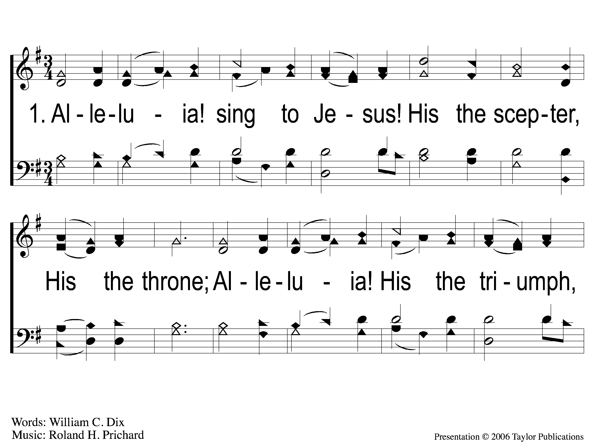
1-1 Alleluia Sing to Jesus
Alleluia! Sing To Jesus
165

Slide 2
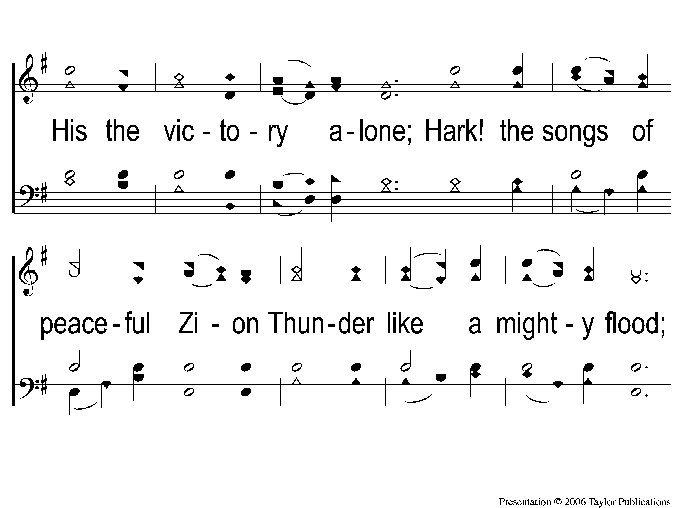
1-2 Alleluia Sing to Jesus
Alleluia! Sing To Jesus
165

Slide 3
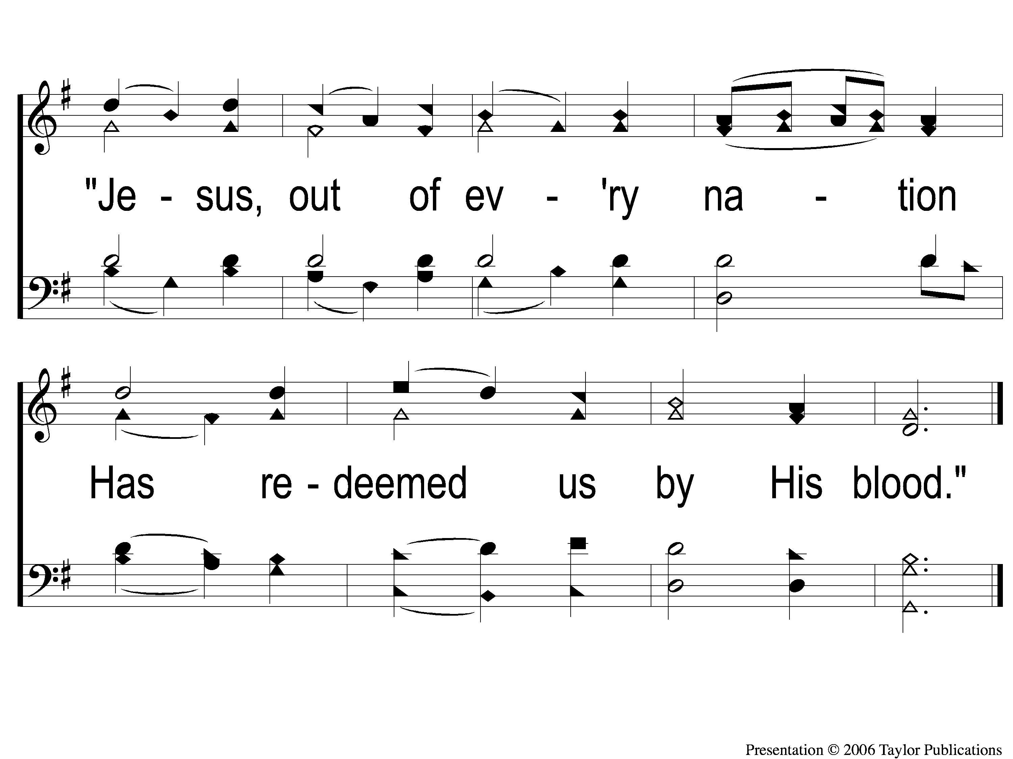
1-3 Alleluia Sing to Jesus
Alleluia! Sing To Jesus
165

Slide 4
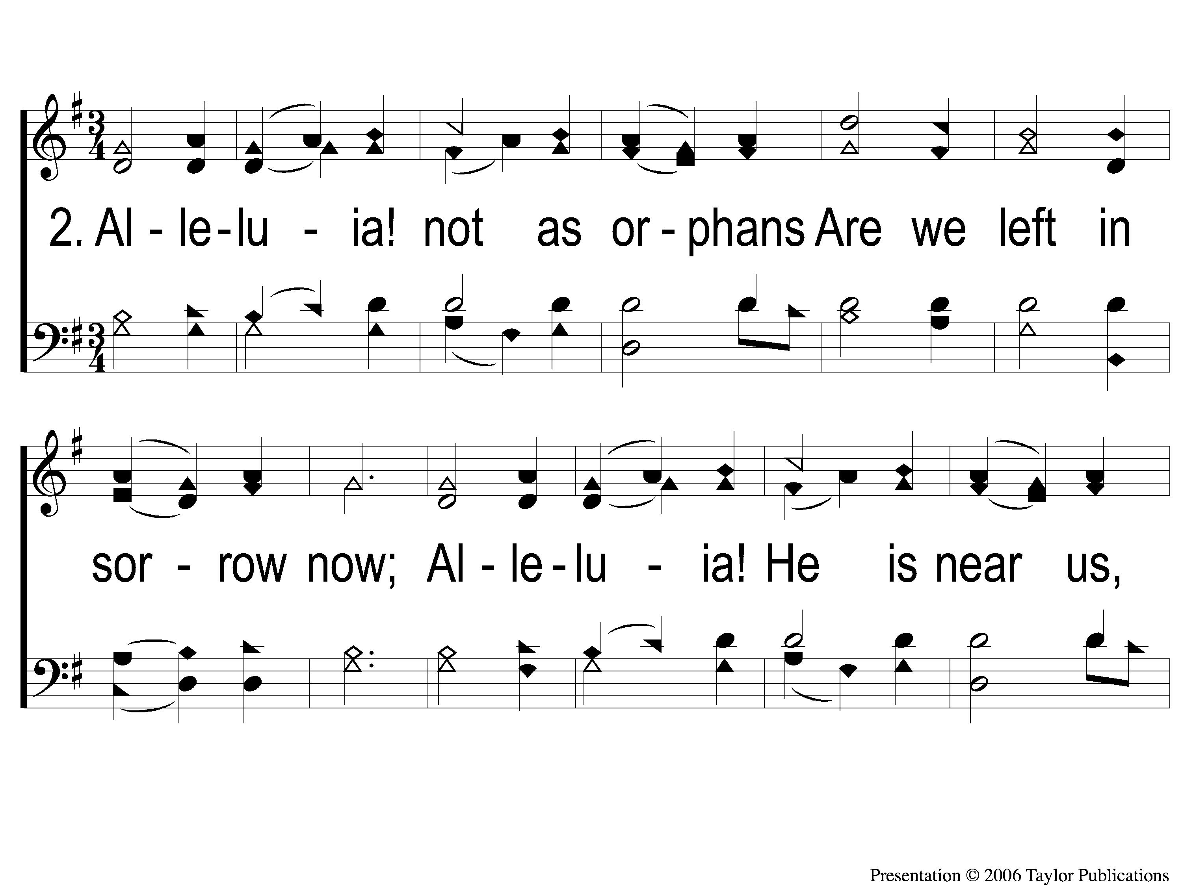
2-1 Alleluia Sing to Jesus
Alleluia! Sing To Jesus
165

Slide 5
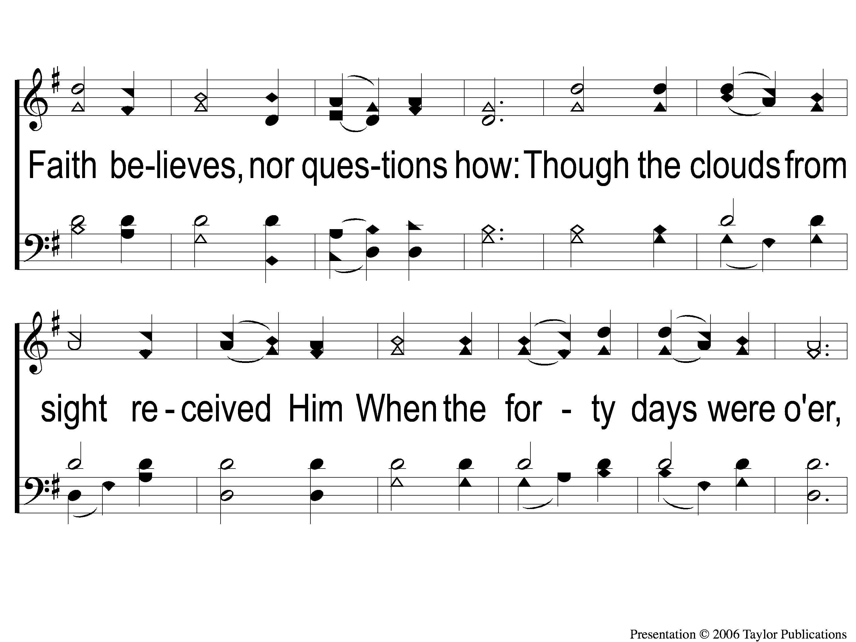
2-2 Alleluia Sing to Jesus
Alleluia! Sing To Jesus
165

Slide 6
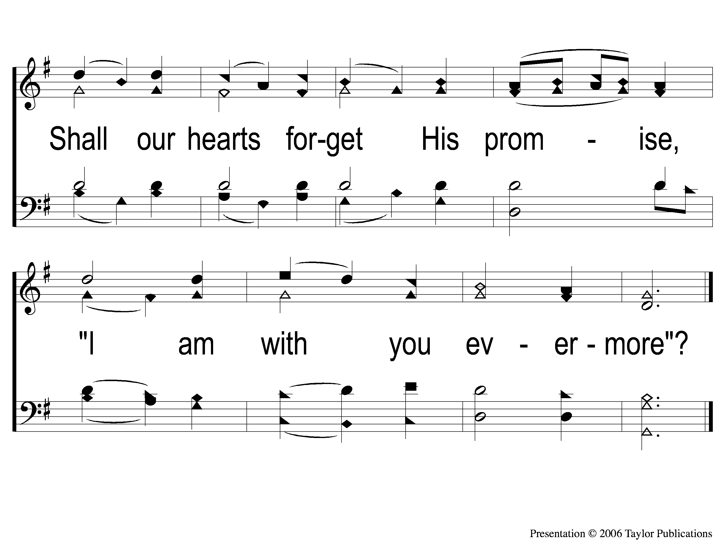
2-3 Alleluia Sing to Jesus
Alleluia! Sing To Jesus
165

Slide 7
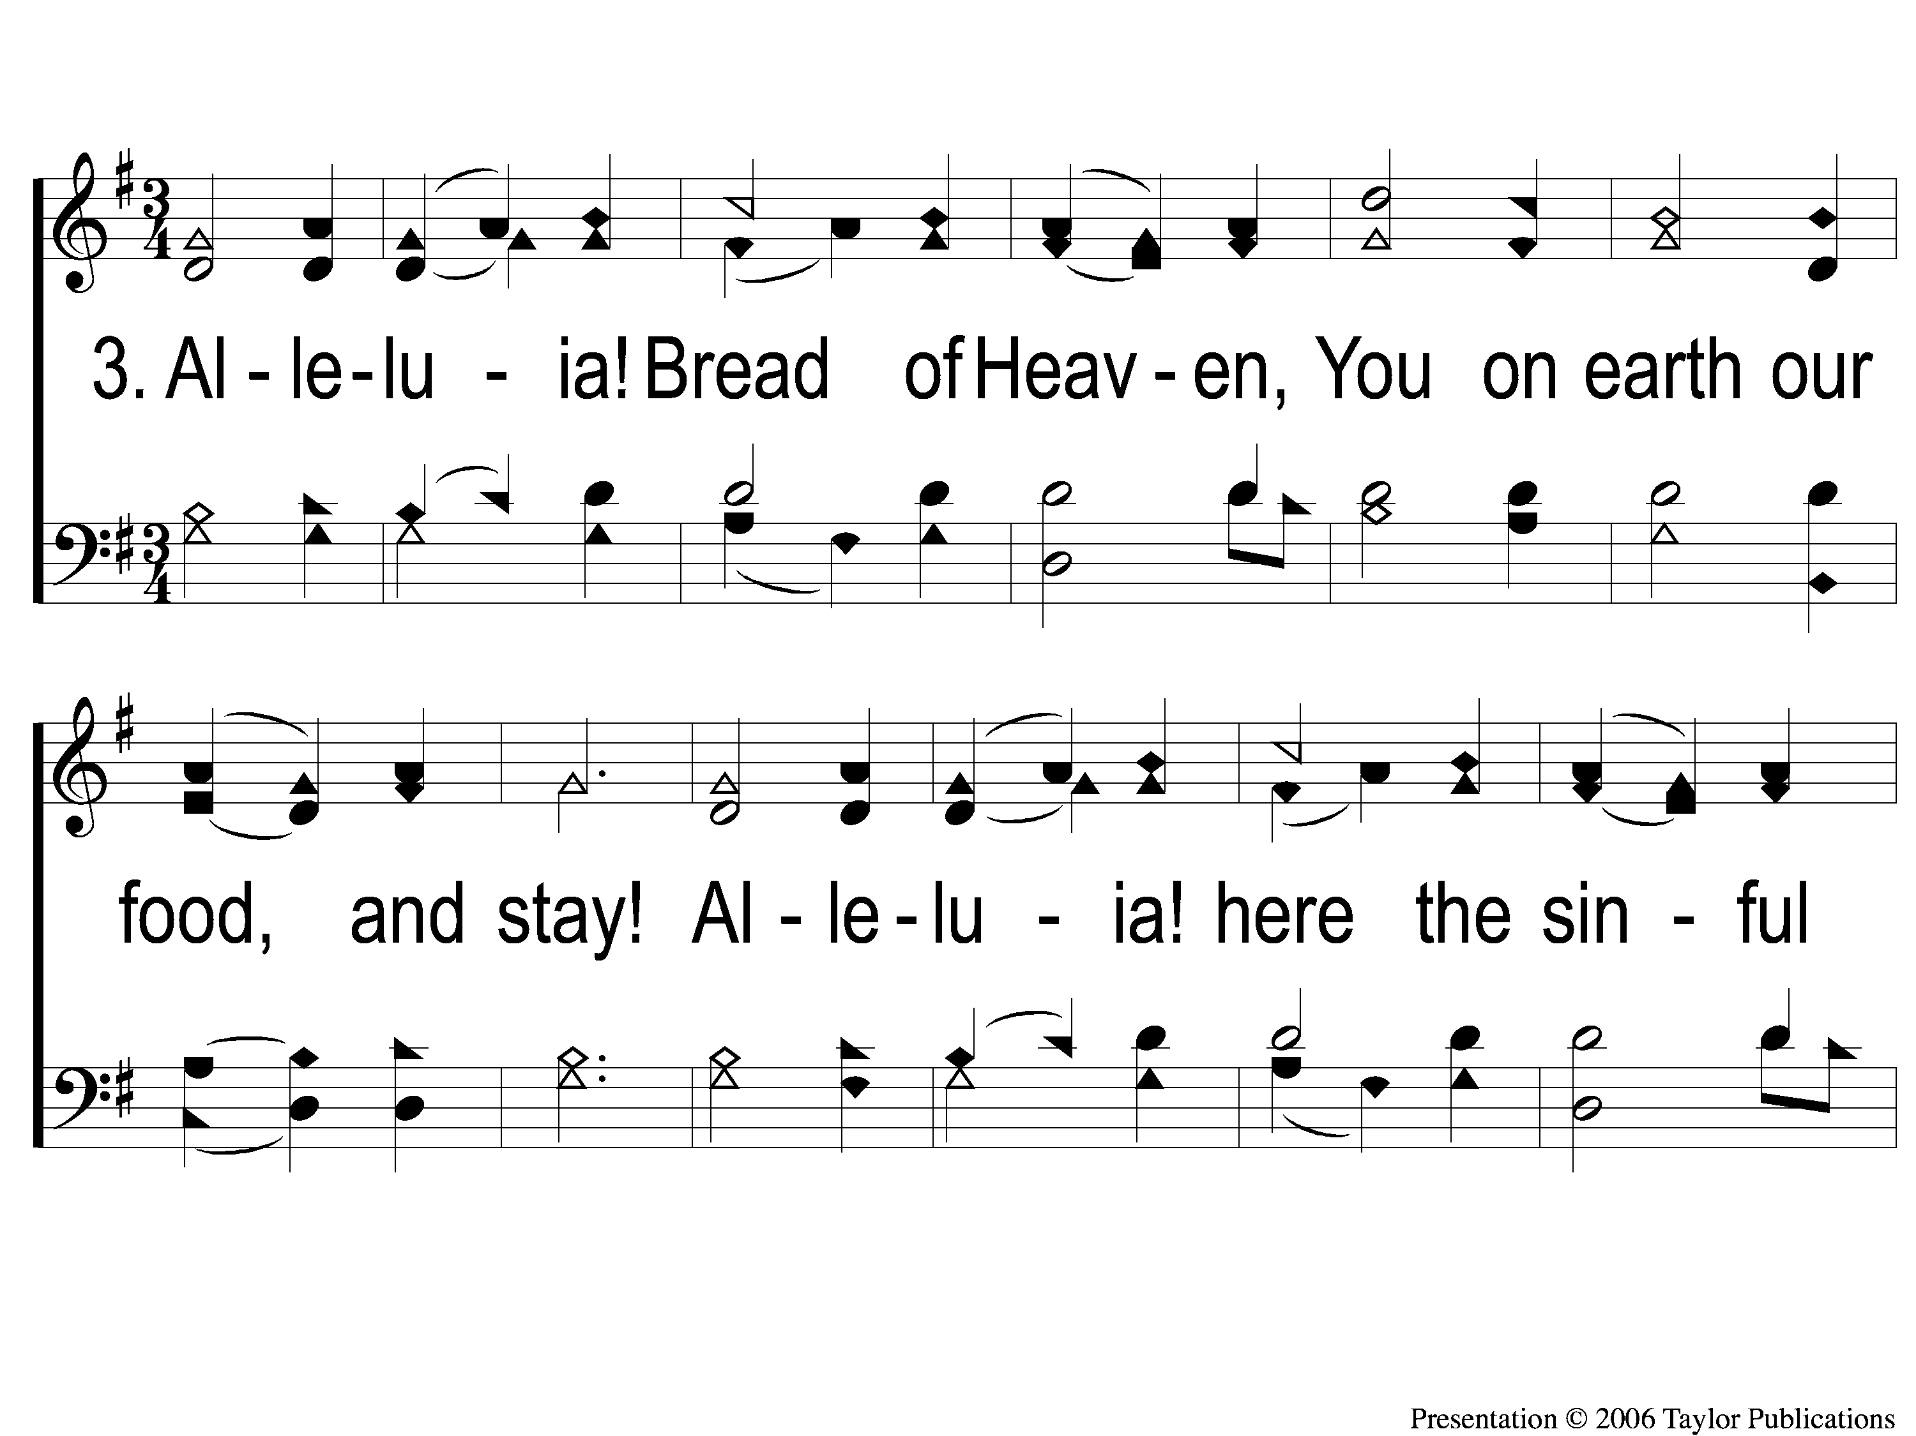
3-1 Alleluia Sing to Jesus
Alleluia! Sing To Jesus
165

Slide 8
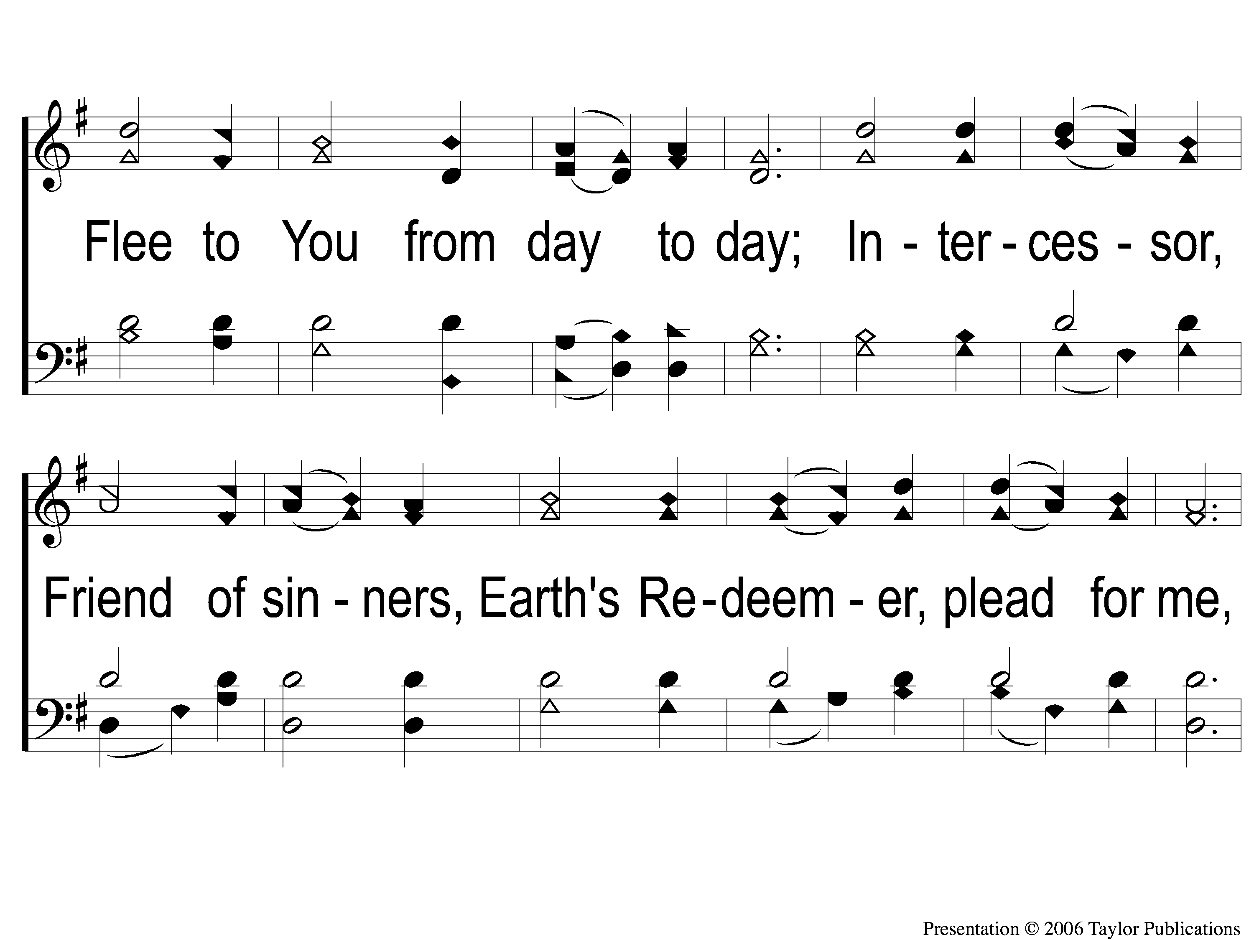
3-2 Alleluia Sing to Jesus
Alleluia! Sing To Jesus
165

Slide 9
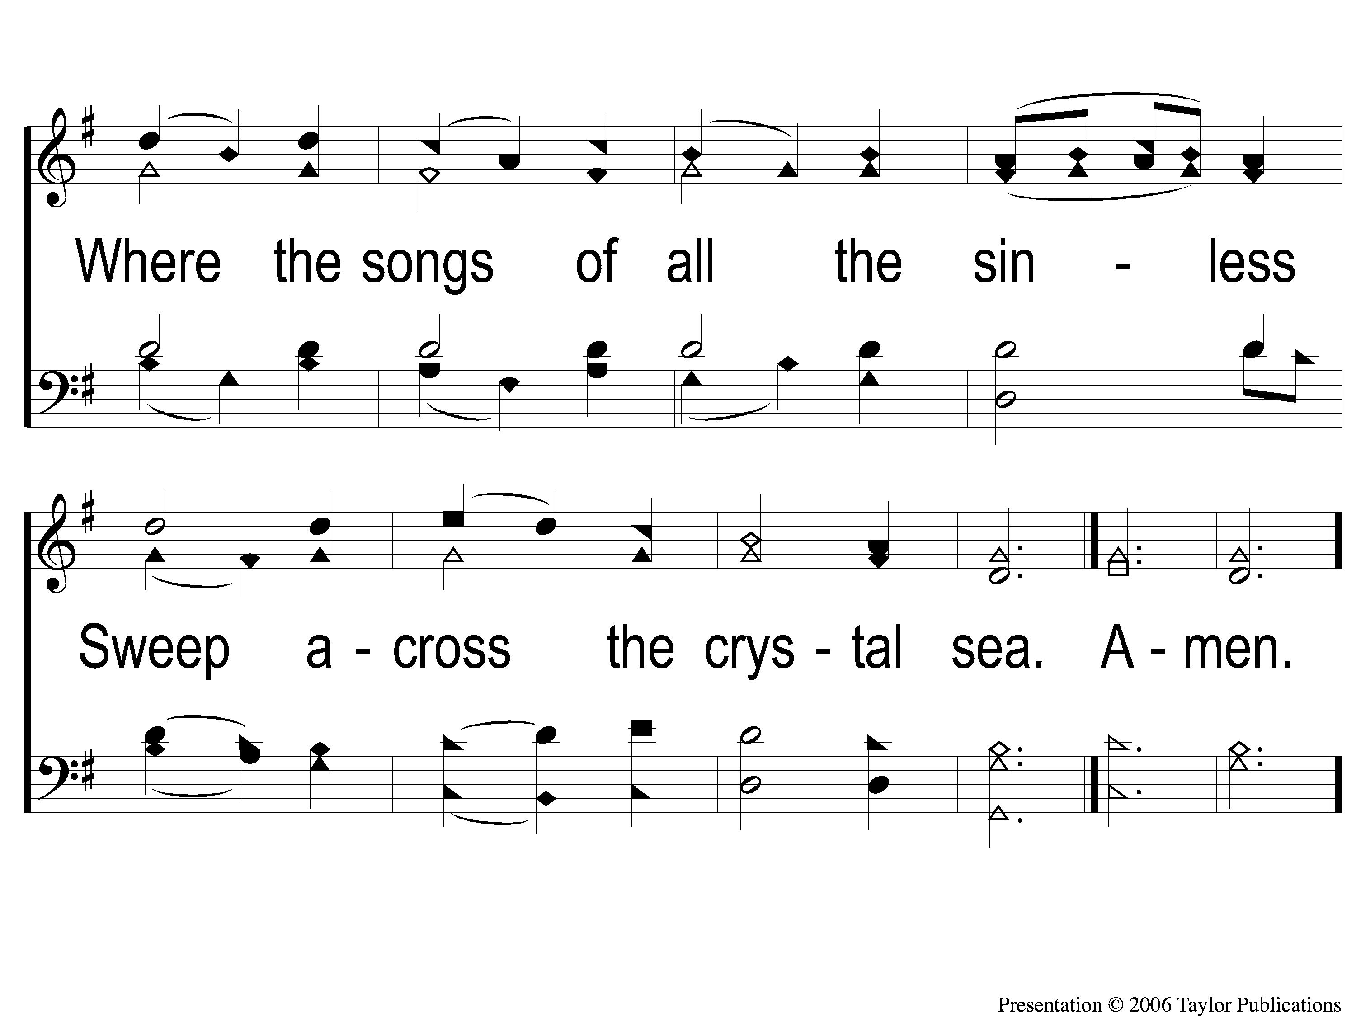
3-3 Alleluia Sing to Jesus
Alleluia! Sing To Jesus
165

